Slide 1
Shortest Path Algorithms

Slide 2
Floyd Warshall All Pair Shortest Path Algorithm
The Floyd–Warshall algorithm is an algorithm for finding shortest paths in a weighted graph with positive or negative edge weights (but with no negative cycles). A single execution of the algorithm will find the lengths (summed weights) of shortest paths between all pairs of vertices.

Slide 3
Algorithm
We initialize the solution matrix same as the input graph matrix as a first step.
Then we update the solution matrix by considering all vertices as an intermediate vertex.
The idea is to one by one pick all vertices and updates all shortest paths which include the picked vertex as an intermediate vertex in the shortest path.
When we pick vertex number k as an intermediate vertex, we already have considered vertices {0, 1, 2, .. k-1} as intermediate vertices.
For every pair (i, j) of the source and destination vertices respectively, there are two possible cases.

Slide 4
Algorithm
1) k is not an intermediate vertex in shortest path from i to j.
We keep the value of dist[i][j] as it is.
2) k is an intermediate vertex in shortest path from i to j.
We update the value of dist[i][j] as
dist[i][k] + dist[k][j] if dist[i][j] > dist[i][k] + dist[k][j]

Slide 5
Example
1
1
8
4
4
2
2
9
1
3

Slide 6
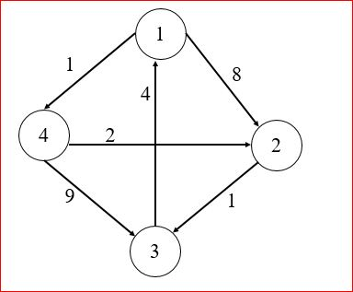
Distance Table of the initial graph
1 2 3 4
1
2
3
4
0 | 8 | ∞ | 1
∞ | 0 | 1 | ∞
4 | ∞ | 0 | ∞
∞ | 2 | 9 | 0
D₀

Slide 7
Distance Table for k = 1
1 2 3 4
1
2
3
4
0 | 8 | ∞ | 1
∞ | 0 | 1 | ∞
4 | 12 | 0 | 5
∞ | 2 | 9 | 0
D₁

Slide 8
Distance Table for k = 2
1 2 3 4
1
2
3
4
0 | 8 | 9 | 1
∞ | 0 | 1 | ∞
4 | 12 | 0 | 5
∞ | 2 | 3 | 0
D₂

Slide 9
Distance Table for k = 3
1 2 3 4
1
2
3
4
0 | 8 | 9 | 1
5 | 0 | 1 | 6
4 | 12 | 0 | 5
7 | 2 | 3 | 0
D₃

Slide 10
Distance Table for k = 4
1 2 3 4
1
2
3
4
0 | 3 | 4 | 1
5 | 0 | 1 | 6
4 | 7 | 0 | 5
7 | 2 | 3 | 0
D₄
So, the last distance table actually contains the shortest distance between all pairs of vertices in the graph.

Slide 11
Distance Tables for k^{th} Iterations
1 2 3 4
1 2 3 4
1
2
3
4
0 | 8 | ∞ | 1
∞ | 0 | 1 | ∞
4 | ∞ | 0 | ∞
∞ | 2 | 9 | 0
1
2
3
4
0 | 8 | ∞ | 1
∞ | 0 | 1 | ∞
4 | 12 | 0 | 5
∞ | 2 | 9 | 0
D₀
D₁
1 2 3 4
1 2 3 4
1
2
3
4
0 | 8 | 9 | 1
∞ | 0 | 1 | ∞
4 | 12 | 0 | 5
∞ | 2 | 3 | 0
1
2
3
4
0 | 8 | 9 | 1
5 | 0 | 1 | 6
4 | 12 | 0 | 5
7 | 2 | 3 | 0
D₂
D₃

Slide 12
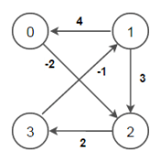
Another Example

